Slide 1
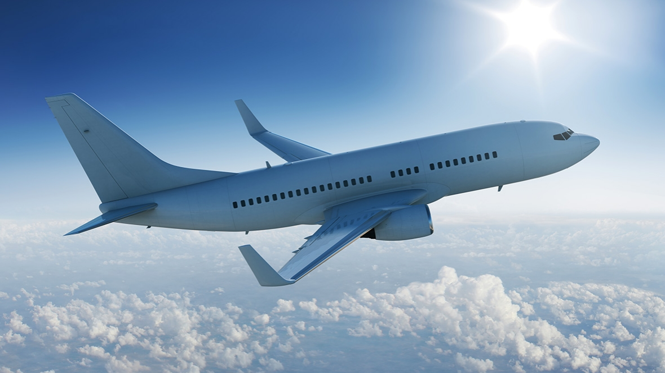
Fly High Fly Safe
By Suyog Potnis
06/25/2018

Slide 2
Synopsis
A well known airline provider wants to:
Understand trends and possible causes of recent decline in Revenue
Gain competitive advantage over its competitors

Slide 3
Overview
Evaluate air traffic data for the year 2014
Drive insights from data points, such as
Popular flown route
Popular flown carrier
Departure Delays
Popular travel day of the week
Actionable Insights
Route Optimization
Carrier Monopoly
Distance Segregation
Day - Time Analysis
Recommendations

Slide 4
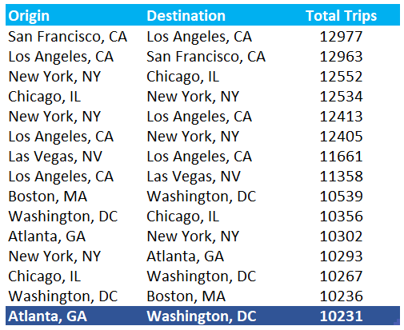
Popular Flown Routes Note: Cancelled flights have been omitted from the analysis below.
Most popular flown route was between San Francisco to Los Angeles.
15th most poplar flow route was between Atlanta to Washington with 10231 Trips

Slide 5
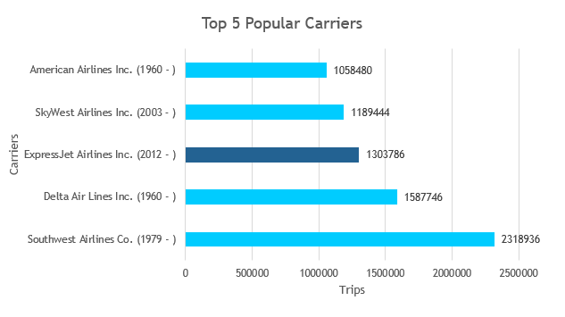
Popular Flown Carriers Note: Cancelled flights have been omitted from the analysis below.
For fiscal year 2014, Southwest Airlines tops the list with 2318936 trips.
Express Jet Airlines was the 3rd most popular carrier with 1303786 trips for fiscal year 2014.

Slide 6
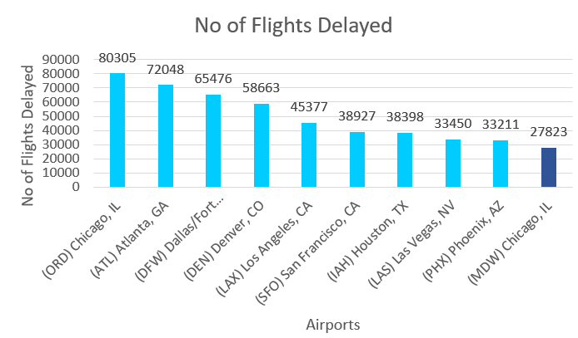
Airports with Most Departure Delays Note: Cancelled flights have been omitted from the analysis below.
Chicago’s O'Hare International Airport had the maximum no of flights delayed for the fiscal year 2014.
Chicago’s Midway Airport came up 10th in the list with 27823 delayed flights.
Note: Used DEP_DEL15 for analysis as anything above 15 min is considered as delayed

Slide 7
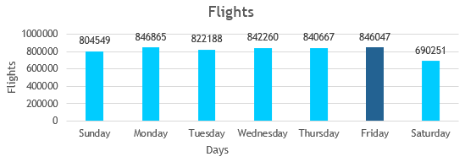
Popular Travel Days Note: Cancelled flights have been omitted from the analysis below.
Second Most Popular day to travel in a week was Friday for the Fiscal Year 2014.
Avg Flight Departure Time on Friday’s for the Fiscal Year 2014 was 13:30. Based on the analysis, Friday Afternoon is when people are either returning home or traveling to their Destinations. This is true among people who travel for work weekly.

Slide 8
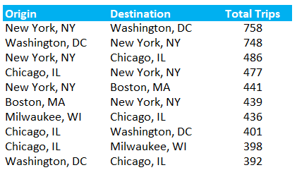
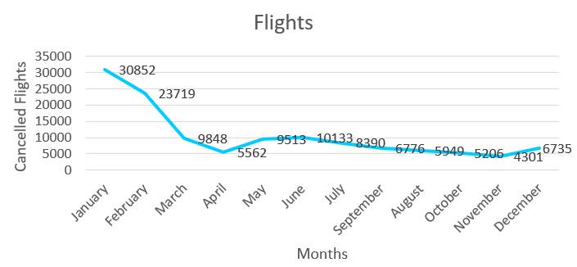
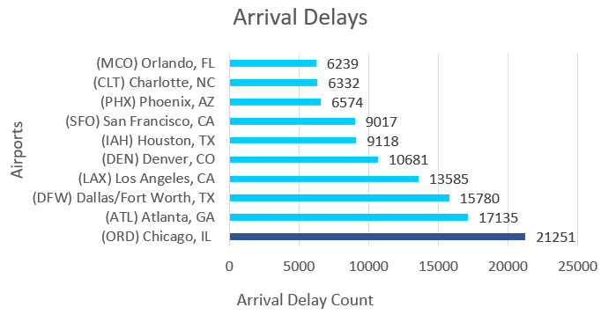
Actionable Insights
Top 10 Routes with Most Cancellations
No of Cancellations Month wise
Maximum Flight Cancellations happened during the months of January and February. Weather could be a primary factor for these cancellations/delays.
Chicago’s O'Hare International Airport topped the chart in both Departure and Arrival delays maximum departure delays.
These insights will help understand revenue loss by locations period wise.
Top 10 Airports with Arrival Delays
Note: Flights that have departed on time but arrived late. ARR_DEL15 has been used for the above analysis. Cancelled flights have been omitted

Slide 9
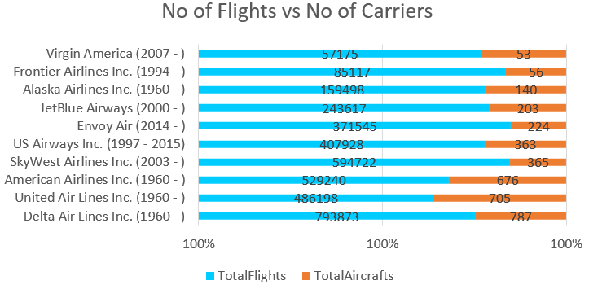
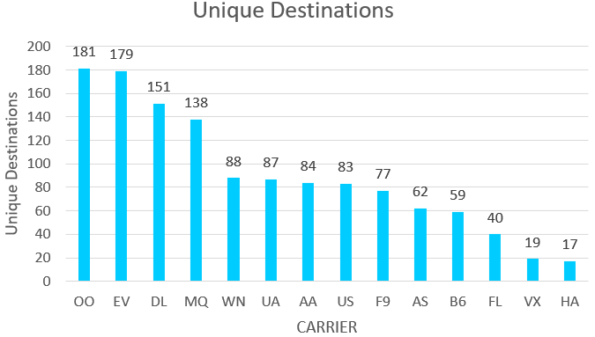
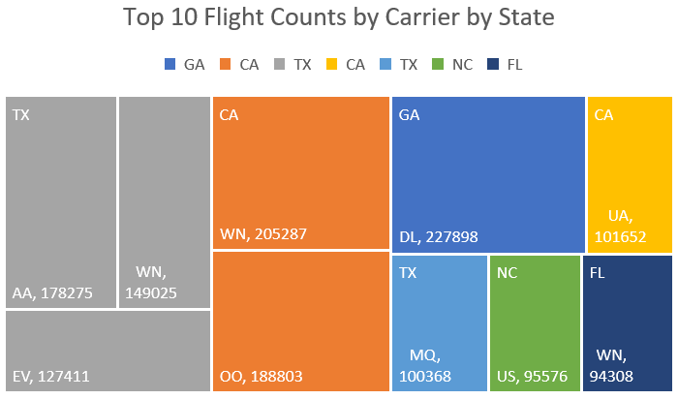
Carrier Monopoly
Carrier Analysis will help in understanding if a carrier has monopoly / partnership with another carrier by state.
Also total no of aircrafts correlates with no of total flights
Unique destinations provides data around if we need to buy additional aircrafts to support these destinations. SkyWest Airlines tops the chart with 181 unique destinations.

Slide 10
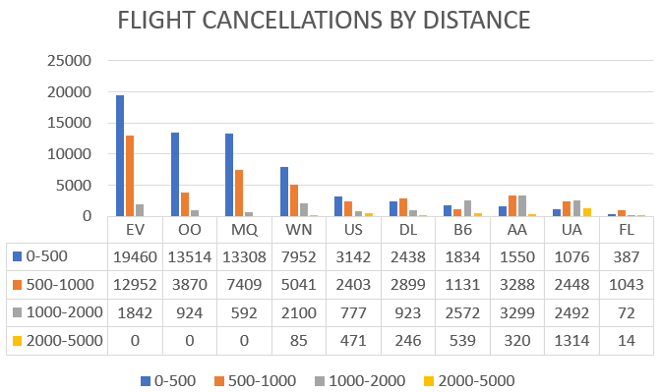
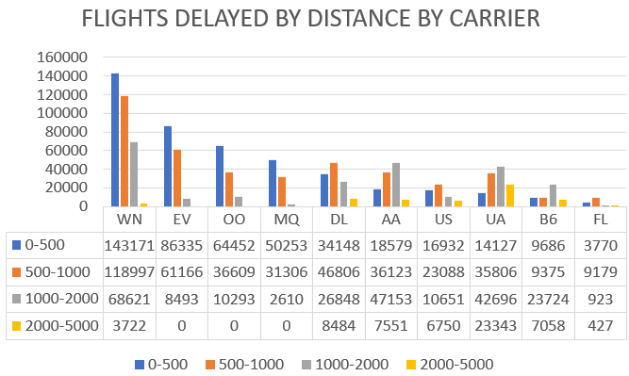
Distance Segregation
Distance
Short Distance flights had the most cancellations with Express Jet Airlines topping the list with 19460 trips.
Short Distance flights has the most delays with Southwest Airlines topping the list with 143171 trips.

Slide 11
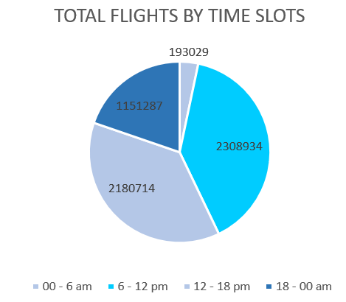
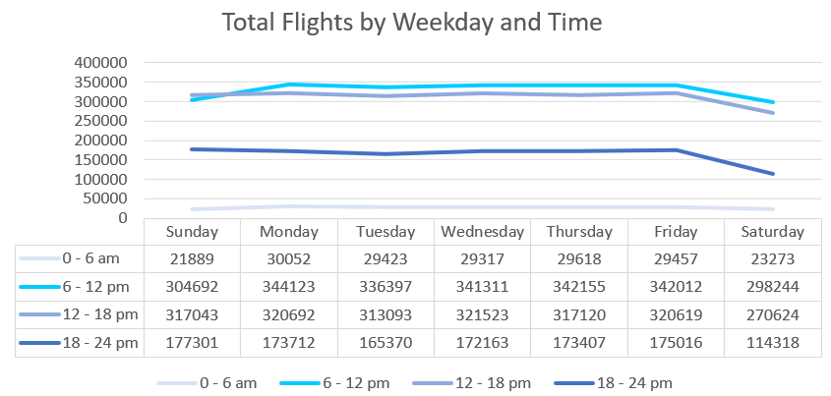
Day - Time Analysis Note: Cancelled flights have been omitted from the analysis below.
6 – 12 pm and 12 -18pm were the busiest time slots for the fiscal year of 2014
Similar pattern is noticed when the data is partitioned by Weekdays.

